Slide 1
"I have nothing to hide" threats to privacy in our society
and how to protect yourself
Notes:
Welcome everybody

Slide 2
Agenda
The awesome cloud
The awful cloud
This thing called privacy
  “I have nothing to hide”
What we need
Getting back your data
Notes:
Good and bad of cloud
Value of privacy
And what you can do to protect it
40 minutes
Interrupt with questions

Slide 3
The awesome cloud
Notes:
Start with the awesomeness of the cloud. Do I need to tell you?

Slide 4
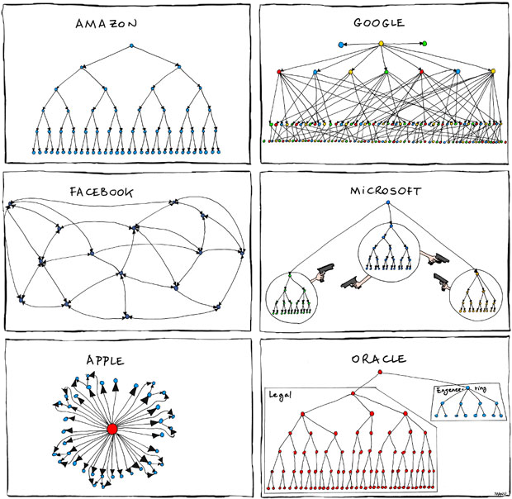
Great cloud services
Organizational charts
pic from xkcd.com
Notes:
Big boys have build great services.
Youtube and Gmail, Facebook, Dropbox, Tumbler and so on – we put our data online because it is great.
Nest, Alexa, Siri…
Limbonic Art → Simon and Garfunkel

Slide 5
Awesomeness of the cloud
Accessible everywhere
Back up online
Easy sharing and collaboration
All free!!!
  (or super cheap)
Notes:
Android phone breaks – log in on new
Games online
Chatting, sharing pics or documents with others
Free or cheap!

Slide 6
The awful cloud
Notes:
Last point – price. How do we pay?
Bad side of the cloud.

Slide 7
Awfulness of the cloud
Where is my data?
Who can access my data?
How is my data used?
Notes:
Ask yourself these questions.

Slide 8
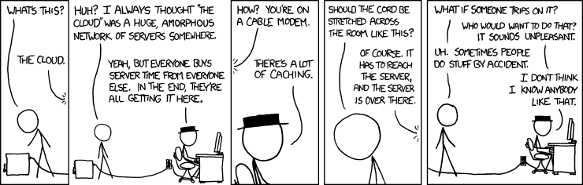
Where is your data?
Notes:
Your data is in the cloud – but that doesn’t answer much questions…
But the more important part is who has access.

Slide 9
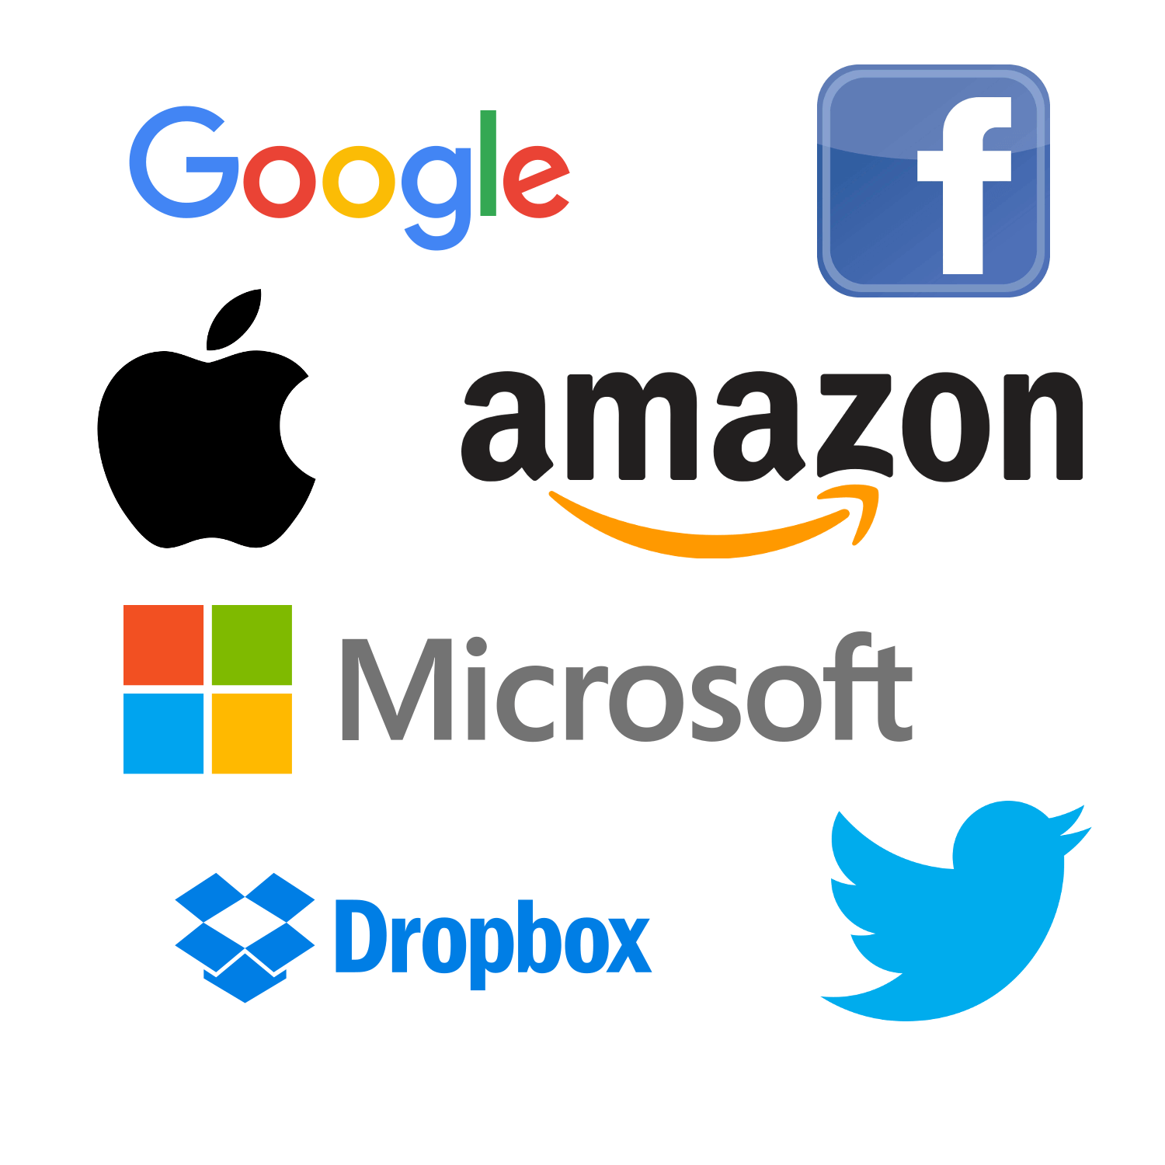

Where’s your data?
Notes:
2 years ago: Dropbox has been deleting copyrighted content.
Last year: Google has been deleting porn. The legitimate kind, created by porn stars for specific customers…
Starting May 1: Microsoft bans ‘offensive language’ and ‘inappropriate content’ from Skype, Office, ...

Slide 10
This thing called privacy
Notes:
Why it matters? Privacy, just that.

Slide 11
What do you have to hide?
You don't know!
You SHOULD have something!
Everybody needs privacy
Notes:
I have nothing to hide.
Well, you do. And you should. Besides, this isn't even the right argument to have.
Let's go over these three points

Slide 12
I - What do you have to hide?
So many rules and regulations...
Changing all the time!
Notes:
having things to hide:
27,000 pages of federal statues (4500 laws) or 10,000 administrative regulations in US.
possessing a live lobster
Being smelly in Washington
animal-rights activists criminally responsible for protests that cause the target of their attention to be fearful, regardless of the protesters' intentions. Congress passed the law in 2006 with only about a half-dozen of the 535 members voting on it. Often no Mens Rea (guilty mind)!!!
Cop with access to everything can take everything
And that is today.
We Dutch remember: largest % of jewish deported due to great records.
Believe me: you have things to hide.
You just don't know what.

Slide 13
II - What you should hide
No government is perfect
If government knew everything...
  Science
  Freedom
  Justice
  What’s next….
Notes:
steps forward often need ppl to hide information and people:
* think of every religion...
* Church access to notes Galileo
* civil dissidents & Jim Crow
* King George & USA independence
Slavery, gay marriage, sodomy laws, women rights...
Government is never perfect. Can't see difference between 'good' and 'bad' disruption

Slide 14

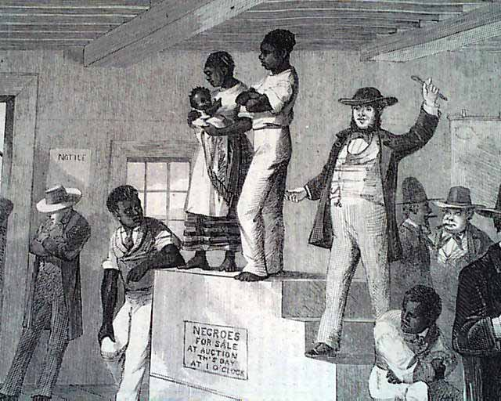
This was legal
Nazi concentration camps
Slavery

Slide 15
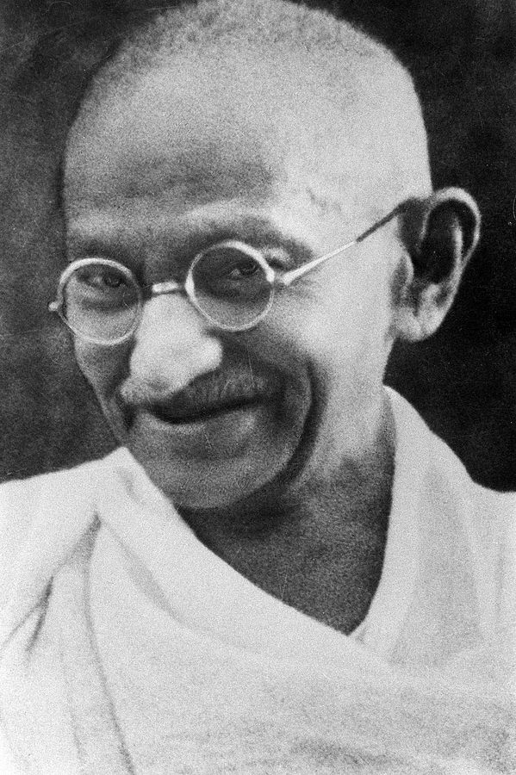
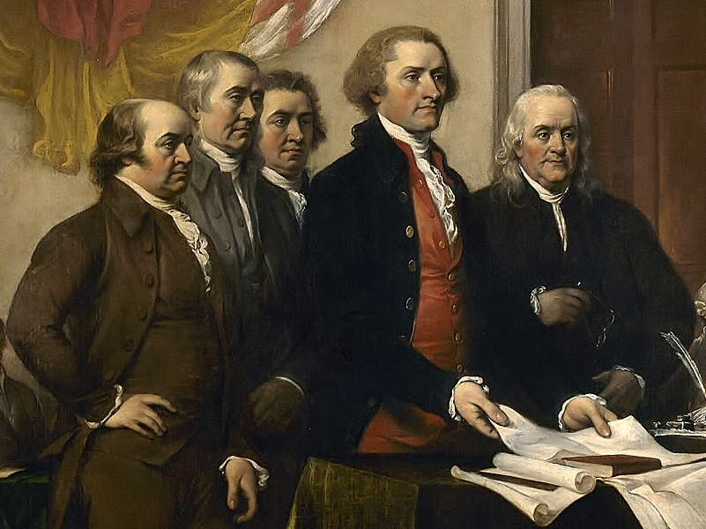
These are criminals
USA’s “Founding Fathers”
Mahatma Gandhi

Slide 16
III - It is a basic need
Control the impression you make on others
  Showers, Make-up, perfume, deodorant? Clothes?
All about 'saving face': who are you?
Notes:
Who needed a shrink?
How much do you care about how others see you?
Dating, soliciting for a job
Family, friends.
Facebook: everybody successful!
Picture of party, not hangover
Loving husband, funny guy, trusted son
Perfect politician – impossible, yes – corrupt

Slide 17
Who is safe?
"If privacy is outlawed,
only outlaws will have privacy."
- from the PGP manual
Notes:
You have, you should and you need something to hide.
Key: privacy eroded. Who gets hurt?
Not government
Not defense contractors, oil companies
Not big arms and drugs traffickers
Not well funded terrorists
You, me, grass-roots political organizations
Annoying journalist? Annoying local charity?
Not just 'evil government': In Mexico, doctor killed for 'bad tweets'.

Slide 18
Getting back your data
Notes:
So, what do we do?

Slide 19
Decentralization
Control:
  Location
  Access rights
Security
  Open Source
Ease of use
Notes:
Federation of data: back to the early days of internet
Decentralized with a communication protocol
Own server or
Bittorrent-like protocols
Open Source

Slide 20
Decentralization protects
Just like real life:
  Use a good lock
  Keep it out of sight
  Don't keep it in one place
Notes:
Real life analogy – translates online.
* Use encryption
* Keep out of sight
iPhone: iCloud. Android: Google Drive.
* Not in one place
Google, Apple security super.
But too interesting for governments to demand, criminals to steal, companies to buy
Much value is in 'big data analysis': correlating, relating. Credit card details – one isn't much, 10K is interesting.
Millions of separate vaults: less secure each, but less interesting.
Think of real neighborhood!

Slide 21
Decentralization protects
"We are all vulnerable to everyone because the NSA wanted us to be vulnerable to them."
- Bruce Schneier
Notes:
One note, because it came up AGAIN. Keeps coming.
Police should have a back door.
No, they should NOT: decrease security for all.
Self-fulfilling prophecy: it is like suggesting to not lock our doors so that if a burglary is in progress the feds can more easily enter our house.
We have ONE infrastructure. There is no world where the US gets to spy but the Chinese can't.
We are secure, or vulnerable.
Greece: phone back doors used by criminals
So backdoors are a BAD IDEA.
Balance – 919 in 1994 vs 4.2 million in Berlin

Slide 22
Take back your data
Notes:
You should be convinced now:
Cloud is awesome
But endangers privacy
And privacy matters
You know what you need: something you OWN.

Slide 23
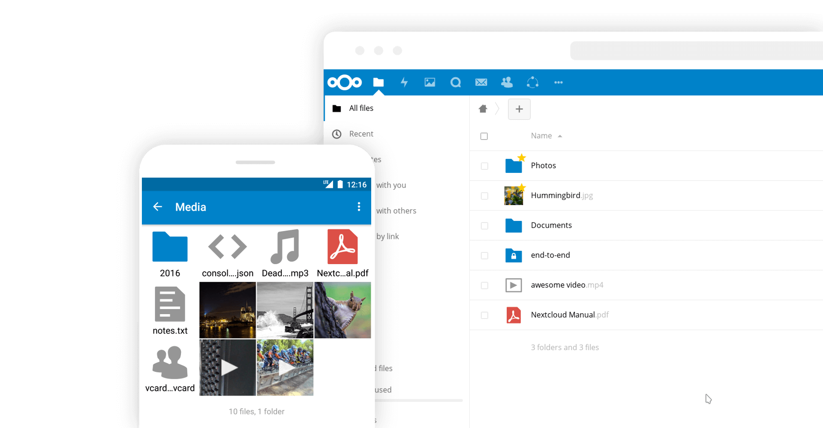
Introducing Nextcloud
Secure data
Private clouds
Cross-cloud sharing
Audio & video chat
Notes:
We need to own our data. And Nextcloud helps you do that.
Nextcloud is a file sync and share technology. You run it on your own server or pick one of the dozens of providers.
Both server and clients are open source and are developed with the goals of being easy to install, use and extend.
Nextcloud has tens of millions of users – by any metric I can think off we’re the biggest self-hosted cloud community.

Slide 24


Easy to use
Easy to deploy: LAMP
Easy to improve on or inspect: PHP, JS, CSS
All-platform access
Scale from Raspberry Pi to 20 mln users
Notes:
Easy...

Slide 25
Sync and Share
Multi-platform
External Storage
  FTP, NFS, WebDAV, dropbox, S3, …
  Encryption
  Versioning
Sharing
  Public links, passwords, expiring, upload rights
Server to server sharing
Notes:
External Storage
* FTP, NFS, WebDAV, dropbox, S3, …
* Encryption
* Versioning
Sharing
Friends took pictures at your wedding?
Send them a public link, expiring in 2 months, protected with a password for uploading files!
Server to server sharing
Federation and decentralization!

Slide 26
Extensible
> 100 Nextcloud Apps
mail, calendar, music, password manager, chat, podcasts, notes… ...
apps.nextcloud.com
Notes:
Nextcloud is a platform you can build apps on
Over 100 available

Slide 27





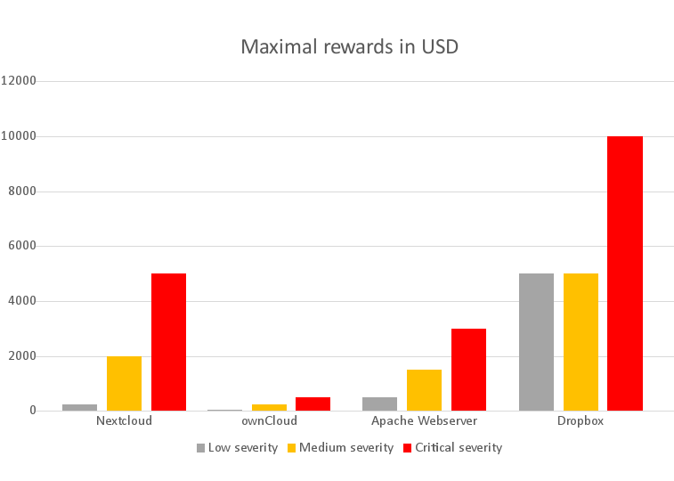
Security of Nextcloud
Documentation
Analysis/threatmodel
Reviews, tests
Security scans, CVE’s
Bug bounty program
Notes:
5K bug bounty

Slide 28
Yours
Open Source
Tens of Millions of users
  Over 1500 contributors, 600 in last year
  github.com/nextcloud
  Nextcloud GmbH for enterprise
Notes:
Most central point: YOU OWN IT.
Fully open
Development on github
AGPL
Etc.
Nextcloud GmbH offers a Nextcloud Subscription for companies, giving access to our development, security and support resources.

Slide 29
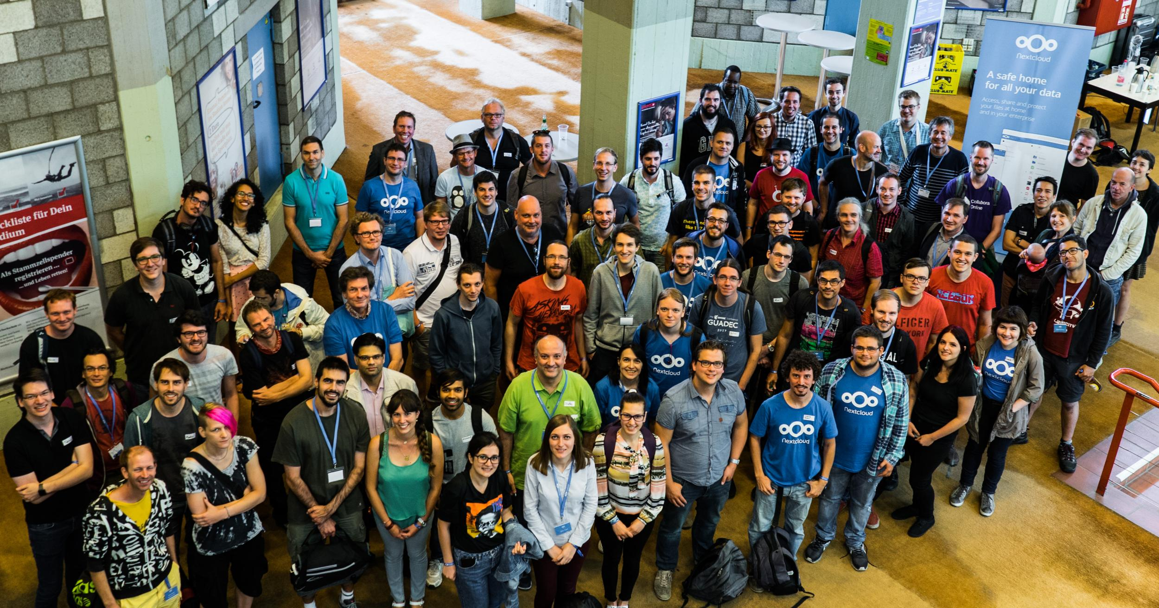
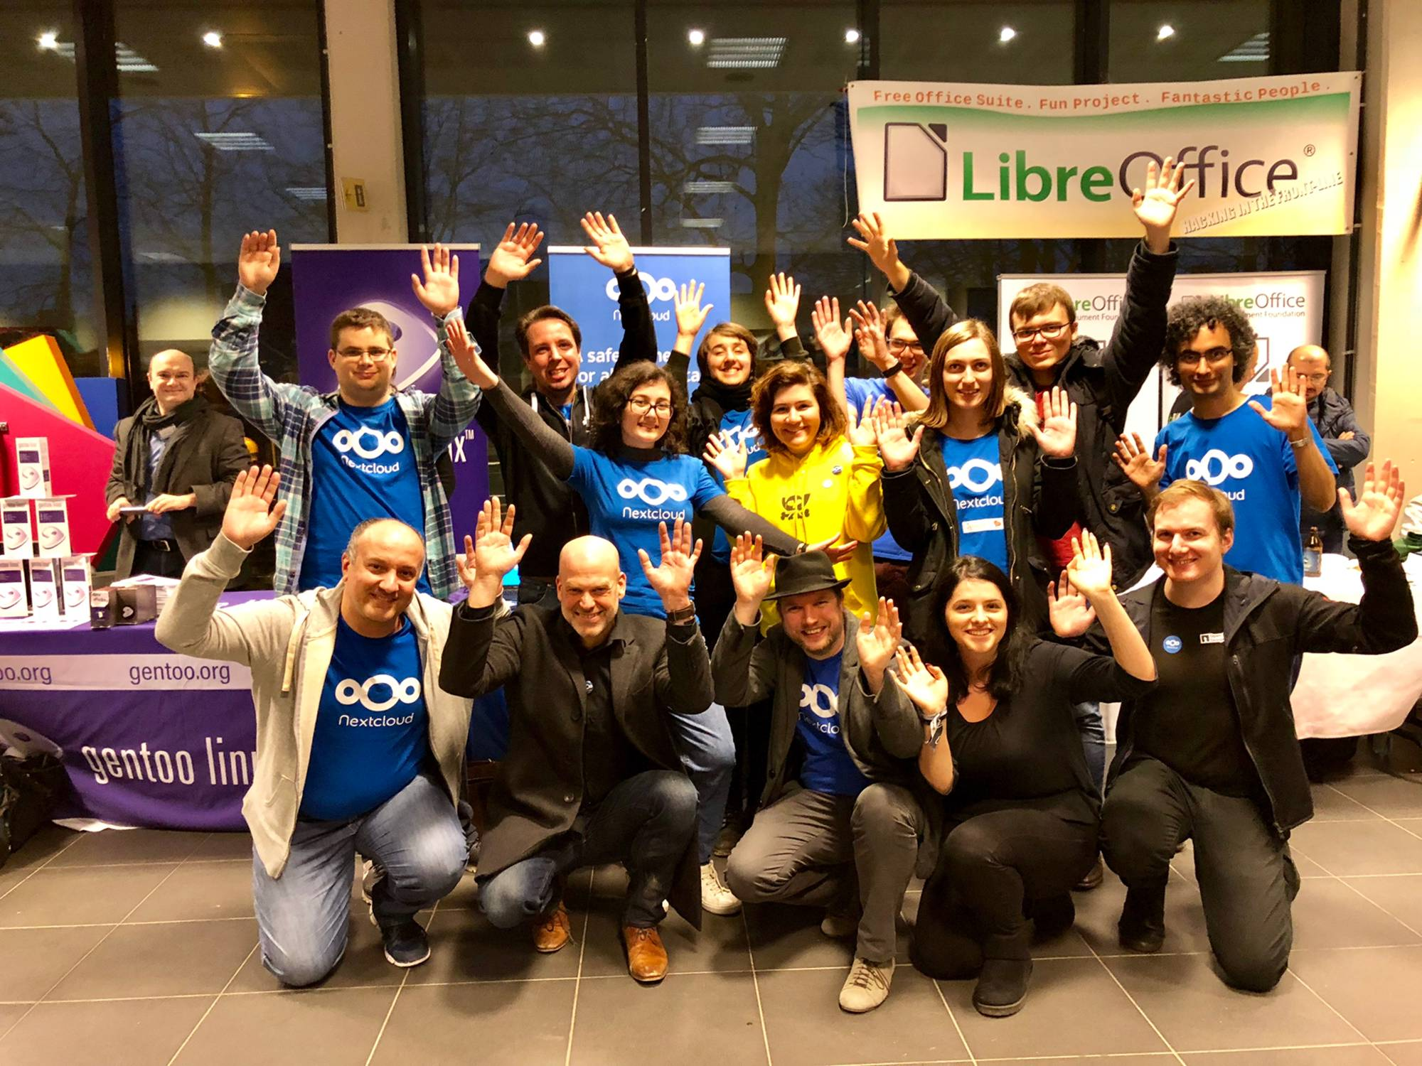
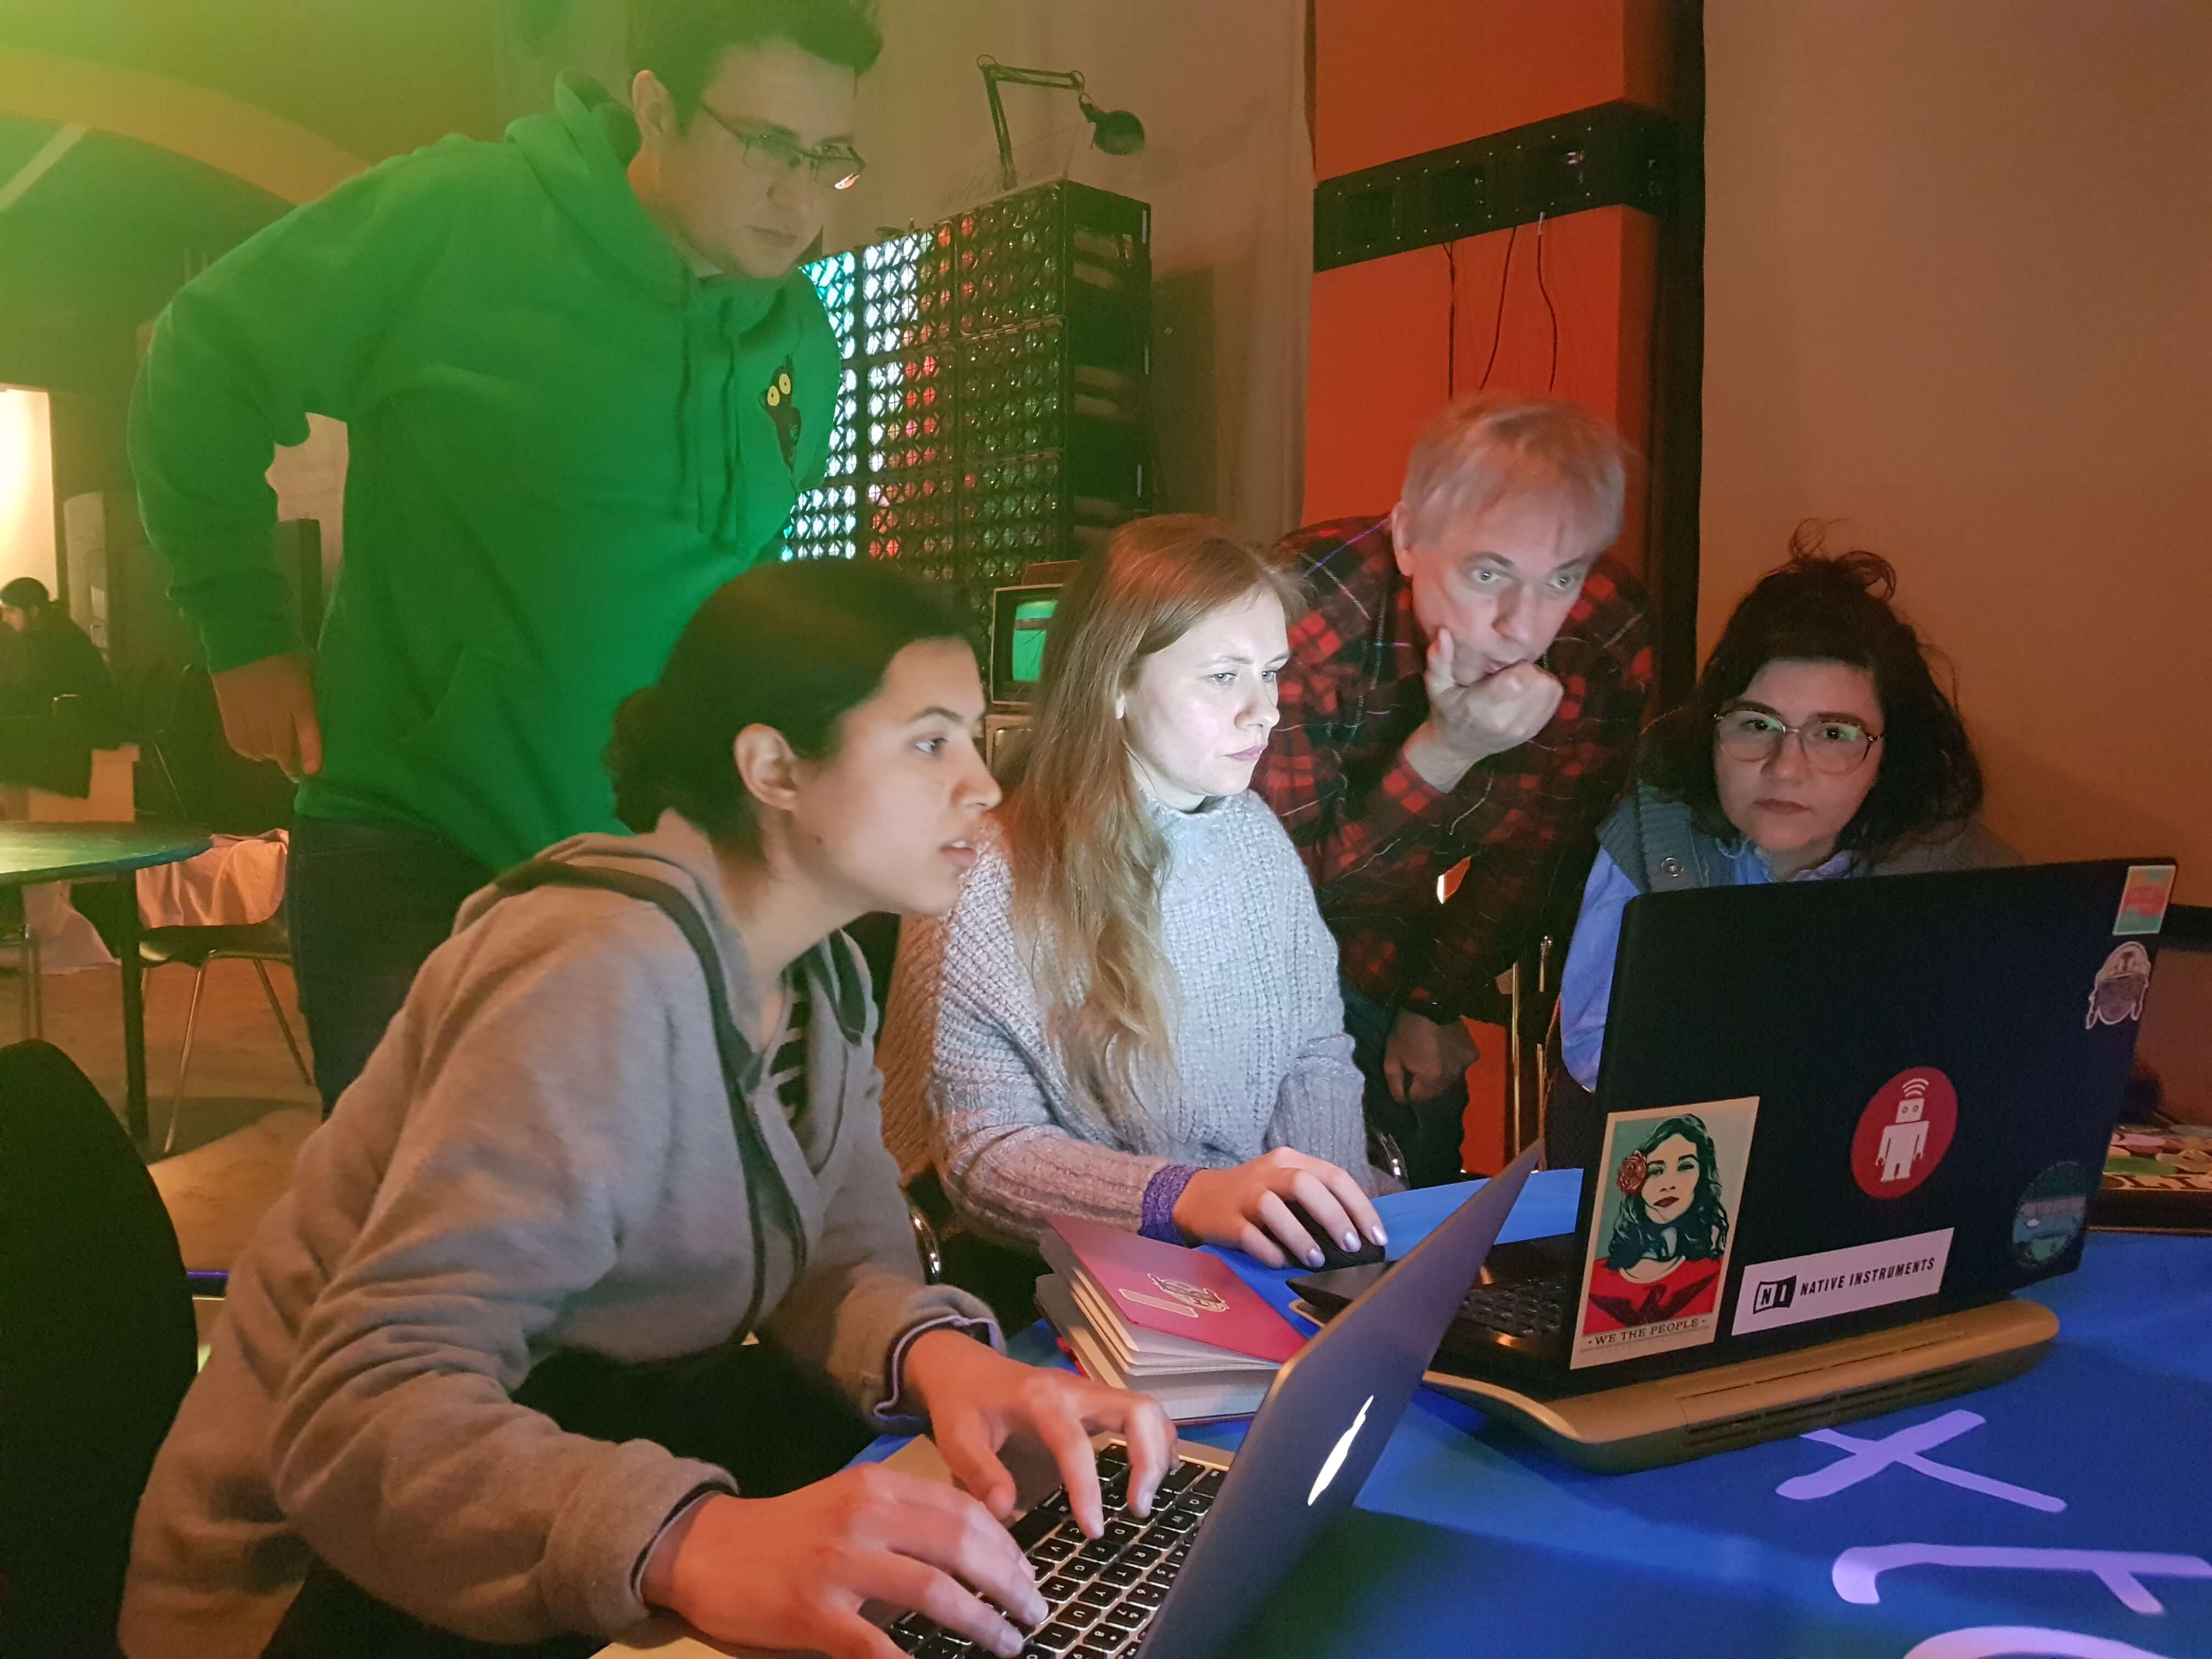
Notes:
100 ppl at conf
Visiting events
Mentoring like RailsGirlsSummerOfCode and Google Summer of Code.

Slide 30
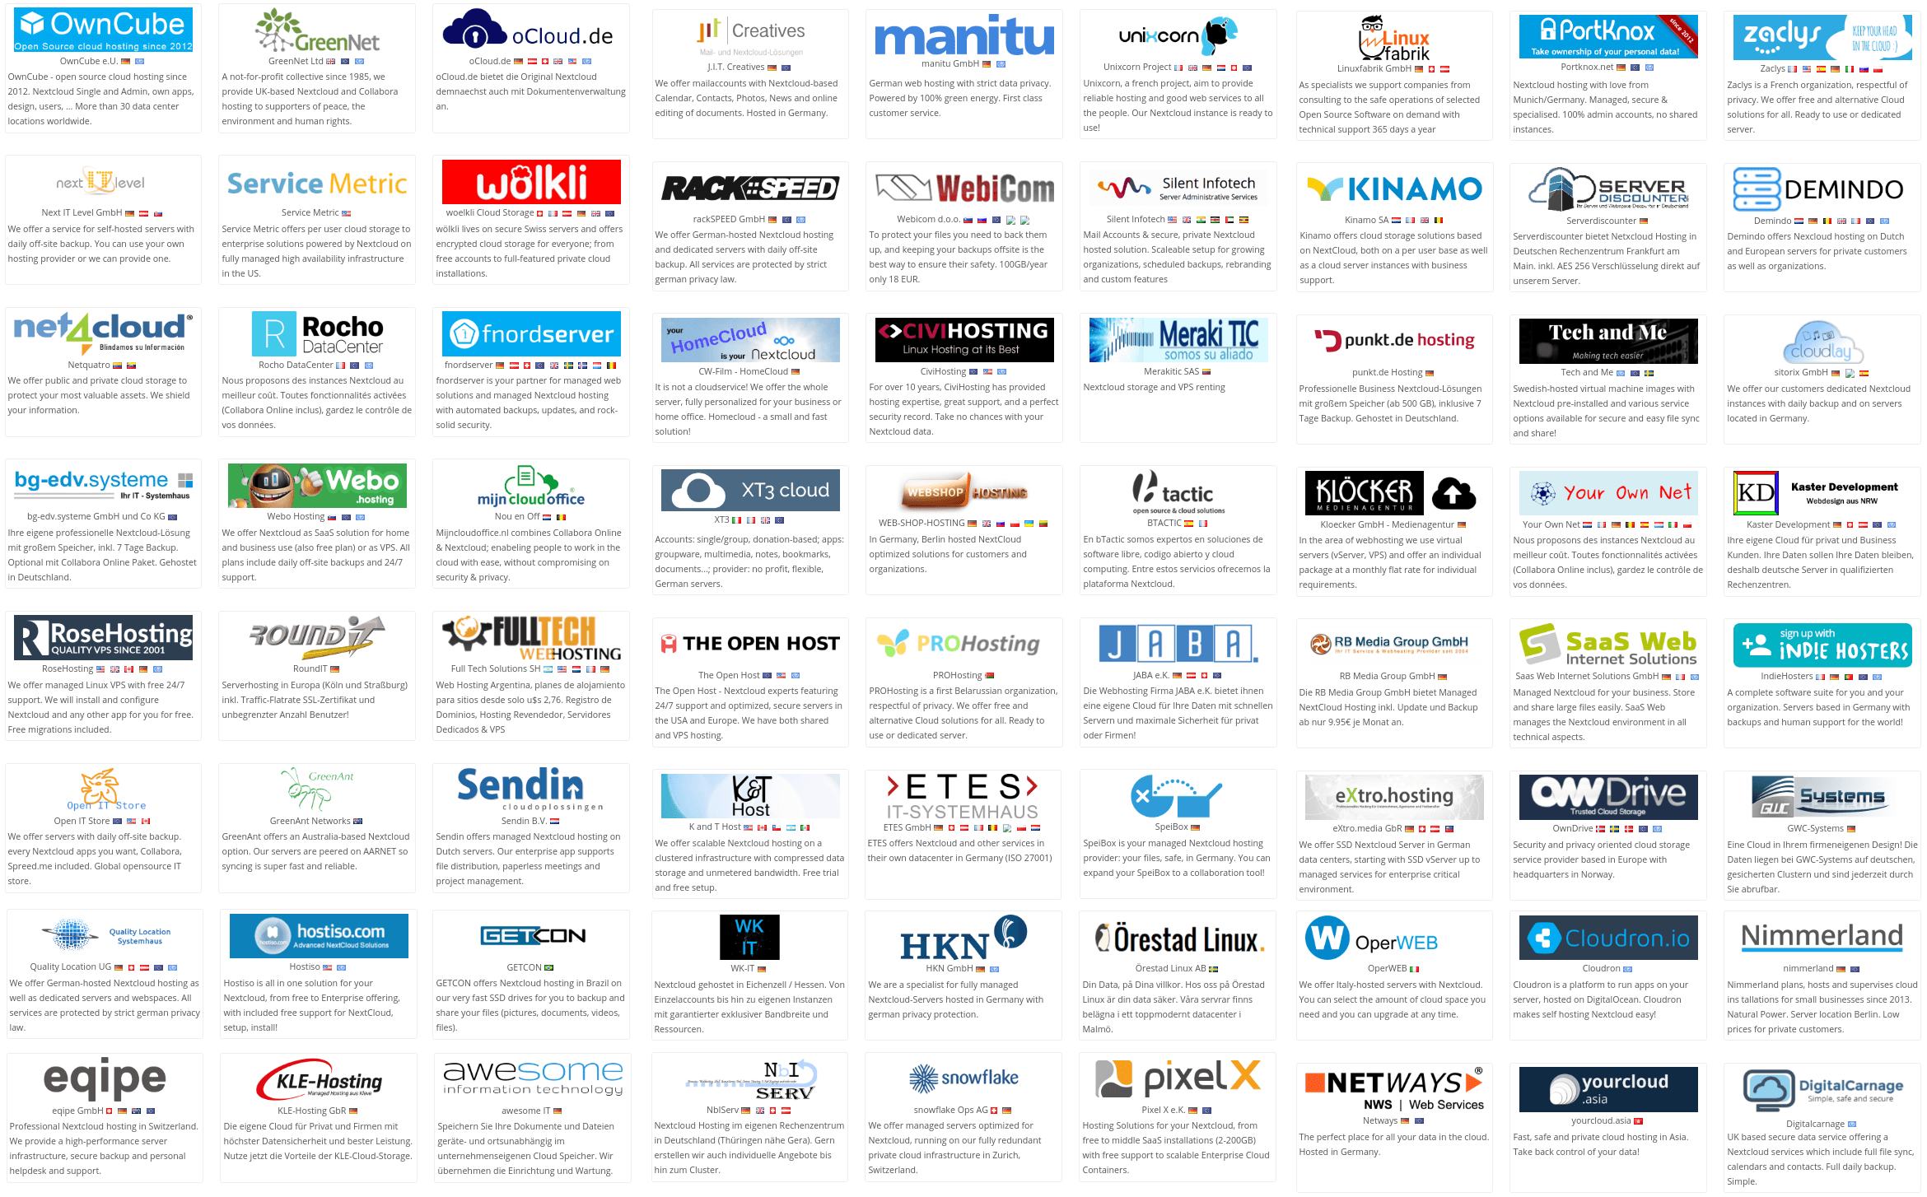
Over 100 providers
Notes:
Server == hard
Providers → decentralization

Slide 31


















We’re not alone of course!

Slide 32
Get started today!
nextcloud.com/install
nextcloud.com/contribute
nextcloud.com/devices
nextcloud.com/providers
nextcloud.com/enterprise

Slide 33
That's it!

